Slide 1
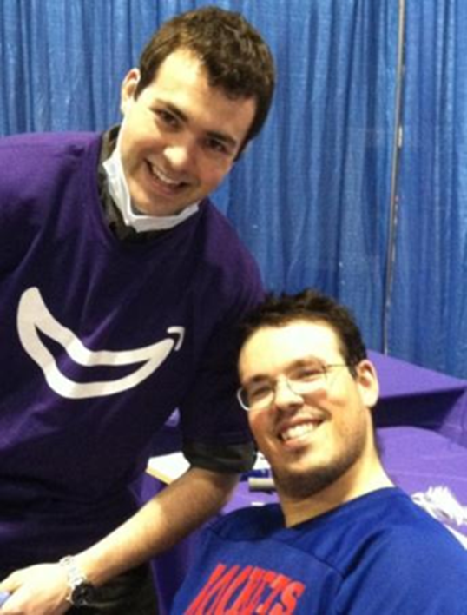
Community Partnerships for Healthy Athletes
Laura M. Robinson, MPH¹, Onolee Stephan, MPH², and Rochester NY Community Partners
¹Strong Center for Developmental Disabilities (SCDD/UCEDD), University of Rochester Medical Center
²Special Olympics New York (SONY)
Team Trainers
Funded by: Special Hope Foundation
Background
Based on international data, Special Olympics (SO) athletes have higher rates of obesity than non-athletes. Despite regular physical activity and training for competitions, athletes could be healthier.
Methods
Partnering with the AADMD Student Chapter at URMC, 3 Team Trainers worked with a SO softball team to encourage preventive health visits, drinking more fluids, and staying active on days without SO activities.
Outcomes
The coach and athletes enjoyed the interactions with the Team Trainers and felt the support was beneficial, especially when it came time to participate in SO Health Athletes screenings.
Next Steps
Pair more Team Trainers with winter teams
Focus more on teaching and less on paperwork
Collect data on health status, healthy behaviors, and event participation for a pilot study
Fitness Inclusion Taskforce (FIT)
Background
Few opportunities exist for SO athletes to exercise outside of SO activities. The Arc of Monroe County, Heritage Christian Services, SCDD/UCEDD, and the Rochester YMCAs partnered to offer YMCA memberships to SO athletes in order to increase physical activity.
Methods
Agency staff will attend an orientation to the YMCA (February 2015)
SO Athletes will attend an open house at the YMCA (March 2015)
YMCA staff will receive training on developmental disabilities, communication strategies, and social support (March 2015)
SO Athletes that join the YMCA can name up to 4 people to accompany them to the YMCA
YMCA data will be used to track health outcomes and surveys will track satisfaction with YMCA services at 3 months, 6 months, and one year after joining
Next Steps
Create curriculum for agency staff orientation to the YMCA and curriculum for YMCA staff
Schedule Open Houses across several YMCAs
Special Smiles
Funded by:
The Golisano Foundation &
Eastman Institute for Oral Health (EIOH)
Background
Special Olympics has offered Healthy Athletes screenings around the world. Despite the availability and continued participation of athletes, dental outcomes are not improving.
Methods
Provided Special Smiles screening at the February 2014 SONY Winter Games. When athletes were recommended to follow-up with a dentist, they were offered a clinic visit at EIOH in May 2014.
Outcomes/Next Steps
17 athletes received follow-up dental care at EIOH in May 2014
Several athletes made EIOH their dental health home
EIOH now hosts a monthly clinic on Saturdays for adults with DD to receive oral care and for dental residents to learn about treating people with DD
EIOH is designing a new Smile-Mobile intervention for the community

